Slide 1
Microprocessor Architecture ECE4375 / ECE5375
Dr. Argenis Bilbao
Spring 2026

Slide 2
Presentation Outline
Advanced Branch Prediction
  Correlating predictor
  Gshare predictor.
  Perceptron predictor.

Slide 3
Branch Prediction, Why?
Execute beyond branch boundaries before the branch is resolved
Correct Speculation
  Avoid stall, performance increases
Incorrect Speculation
  Abort/squash/flush incorrect instructions
  Undo any incorrect state changes
Two types: Static and dynamic branch prediction

Slide 4
Static Branch Prediction
Simplest branch prediction approach
  E.g. assume forward branches not taken
  E.g. assume backward branches are taken

Slide 5
Dynamic Branch Prediction
Branch behavior is monitored during program execution
  History data can influence prediction of future executions of the branch instruction
Branches instruction execution has two tasks/predictions
  Condition evaluation (taken or not-taken)
  Target address calculation (where to go when taken)
Target prediction also applies to unconditional branches
Branch Target Prediction:
  Tries to guess to which address the PC must be set to before evaluation is completed.
  Branch history tables, 2-bit predictor, hybrid predictors

Slide 6
Correlating Branch Predictors
1 and 2-bit branch predictors exploit most recent history of the current branch
Realization! Branches are often correlated. This fact may be exploited to gain performance
  A branch outcome may be correlated with past outcomes of the same branch, not just the most recent outcome!
  A branch outcome may be correlated with past outcomes of other branches.

Slide 7
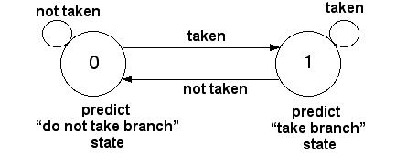
Dynamic Branch Prediction Table
1-bit predictor
Stores 1-bit values to indicate whether the branch is predicted to be taken or not.
The lower N bits of the branch address are used to index this table.
If the prediction fails, the CPU flips this bit and flushes
pipeline
Somewhat accurate for long loops.
Not very accurate for short loops or
if statements.
Ex: Loop that repeats 3 times.
First and last iteration will be wrong.
33% accuracy

Slide 8
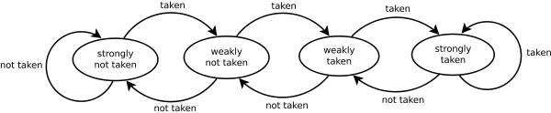
Dynamic Branch 2-Bit Predictor
This prediction mechanism changes a prediction only if two successive mispredictions occur.
2-bits are stored in the prediction table.
Two states correspond to a taken prediction.
Two states correspond to a not taken prediction.
Advantage: a few atypical branches will not influence the prediction.
Especially useful when multiple branches share the same counter/table index.
In practice misprediction rates for 2-bit predictors with 4096 entries in the table range from 1% to 18%
00
01
10
11

Slide 9
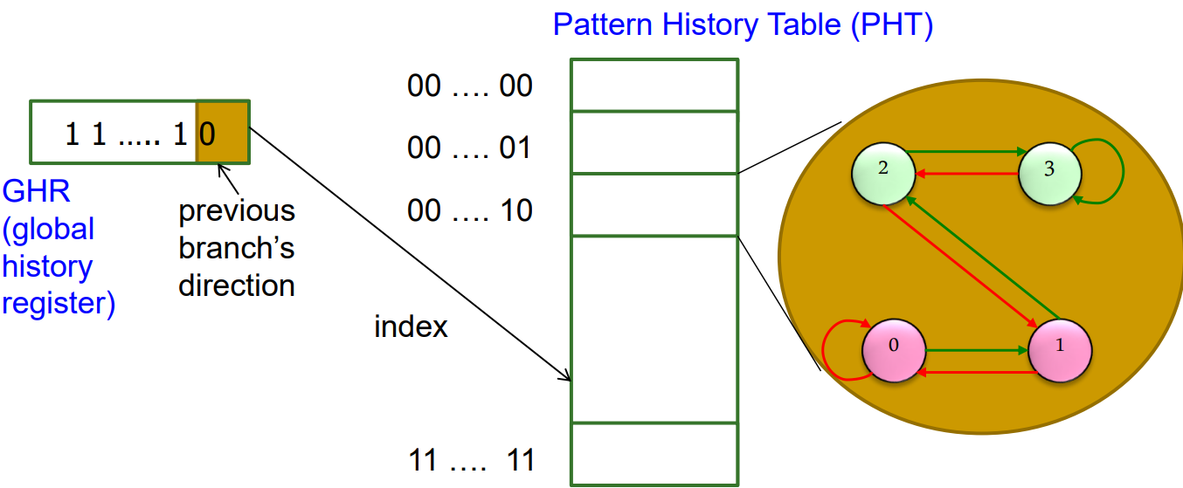
Correlating Branch Predictors (Two-level)
First level: Global branch history table (BHT)/GHR - N bits
  Describes the direction of the last N branches
Second level: A table of saturating counters indexed by each of the entries in the GHR – Pattern History Table (PHT)

Slide 10
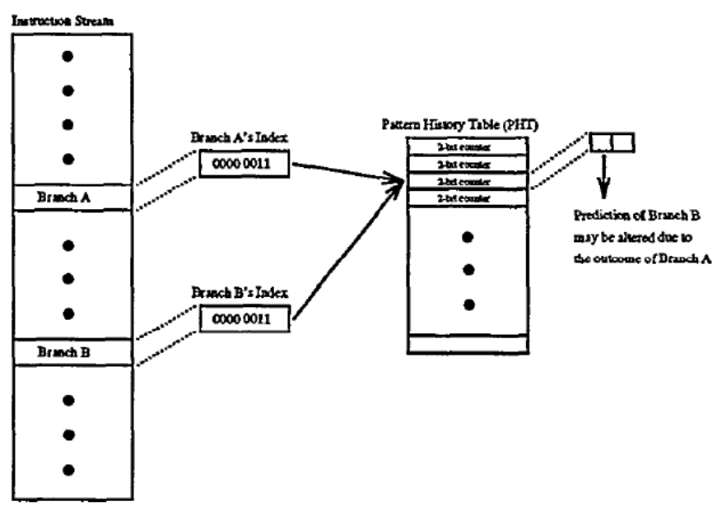
Interference
Sharing PHTs between histories or branches leads to interference
  Different branches map to the same PHT entry and modify it
  Interference can be positive, negative, or neutral
Interference can be
eliminated by dedicating
a PHT per branch
  Too expensive
How else can we eliminate
or reduce interference?

Slide 11
Reducing Interference
Increase size of BHT / PHT
Branch filtering
  Detect biased branches
    Use static prediction as previously mentioned
Hashing / Index-randomization
  Gshare
  Gskew
Agree prediction

Slide 12
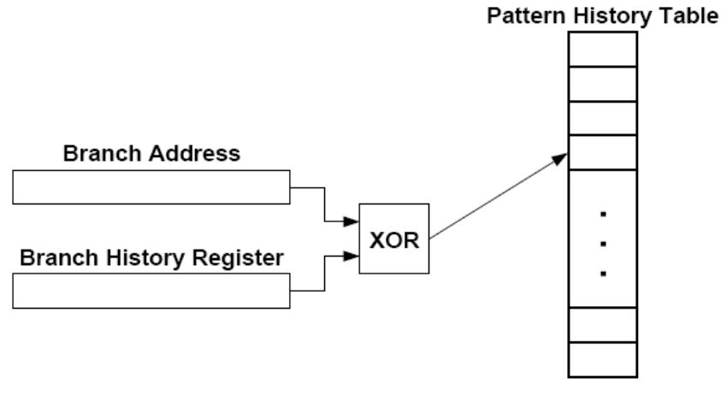
Gshare Predictor
Randomize the indexing function into the PHT such that probability of two branches mapping to the same entry reduces
  Gshare predictor: BHT hashed with the Branch address
    Better utilization of PHT
    More context information
    Increases access latency
Branch History Table

Slide 13
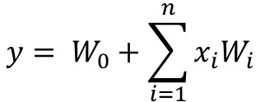
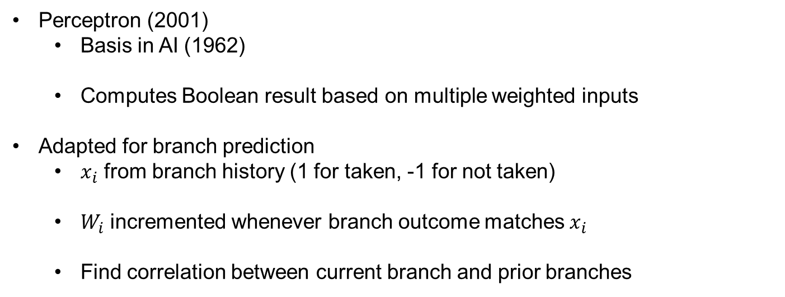
Perceptron Branch Prediction
Perceptron (2001)
  Basis in AI (1962)
  Computes Boolean result based on multiple weighted inputs
Adapted for branch prediction
  $x_{i}$ from branch history (1 for taken, -1 for not taken)
  $W_{i}$ incremented whenever branch outcome matches $x_{i}$
  Find correlation between current branch and prior branches
$$y= W_{0}+\sum_{i=1}^{n}{x_{i}W_{i}}$$

Slide 14
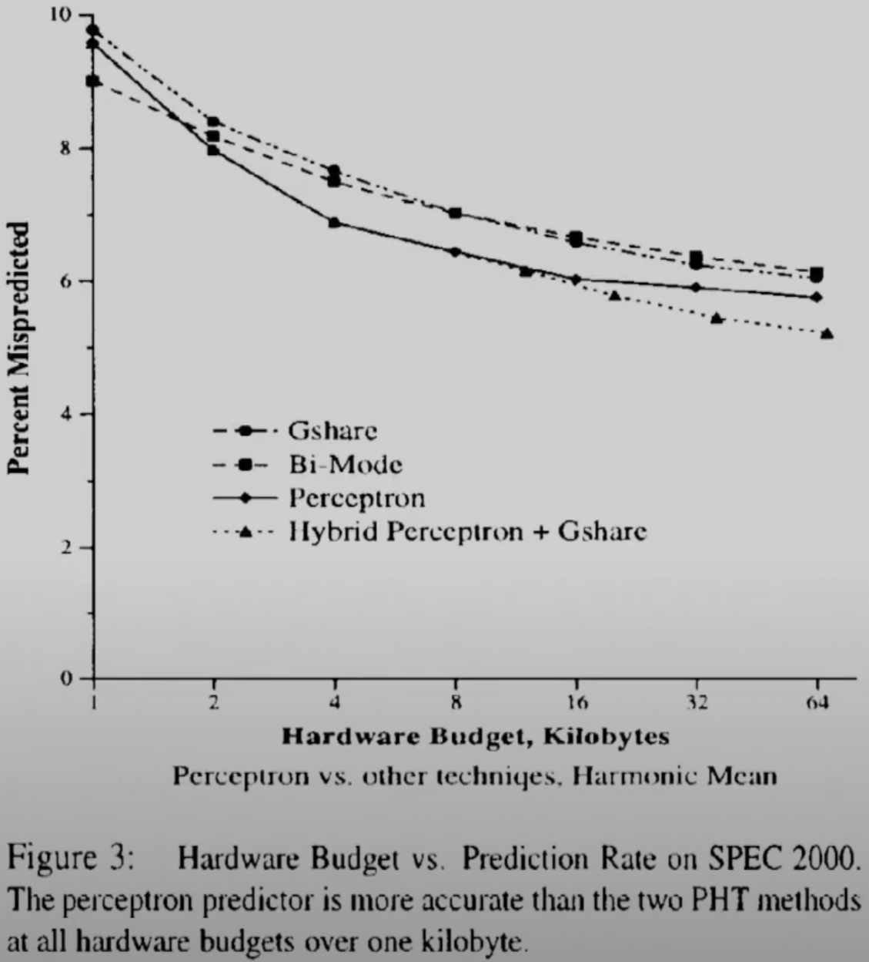
Perceptron - Performance

Slide 15
Sources
http://www.eecs.harvard.edu/cs146-246/
Assigned Textbook
https://course.ece.cmu.edu/~ece740/f15/lib/exe/fetch.php?media=18-740-fall15-lecture05-branch-prediction-afterlecture.pdf

